Slide 1
Olympic Data Analysis
Project 2 – Team TECC (Tom, Erika, Cris, Cat)

Slide 2
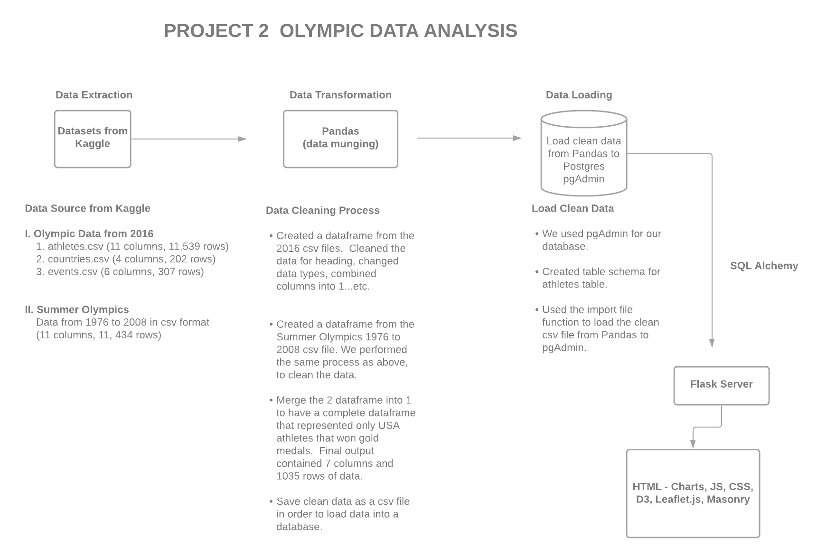

Slide 3
Kaggle Datasets
Dataset 1
https://www.kaggle.com/rio2016/olympic-games
athletes.csv
countries.csv
events.csv
Dataset 2
https://www.kaggle.com/divyansh22/summer-olympics-medals
Summer-Olympic-madals-1976-to-2008.csv

Slide 4
Data Transformation
Pandas – Data Munging
Created pandas dataframes based on the csv files

Slide 5
Charts
Libraries used for Charting
Plotly
D3
Leaflet

Slide 6
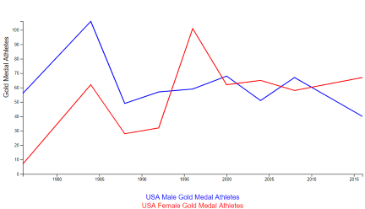
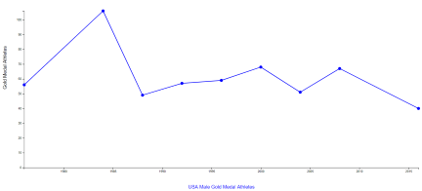
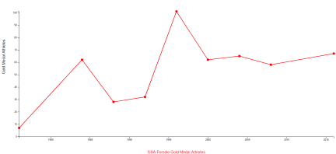
Gender Line Charts – Used D3 for Charting

Slide 7
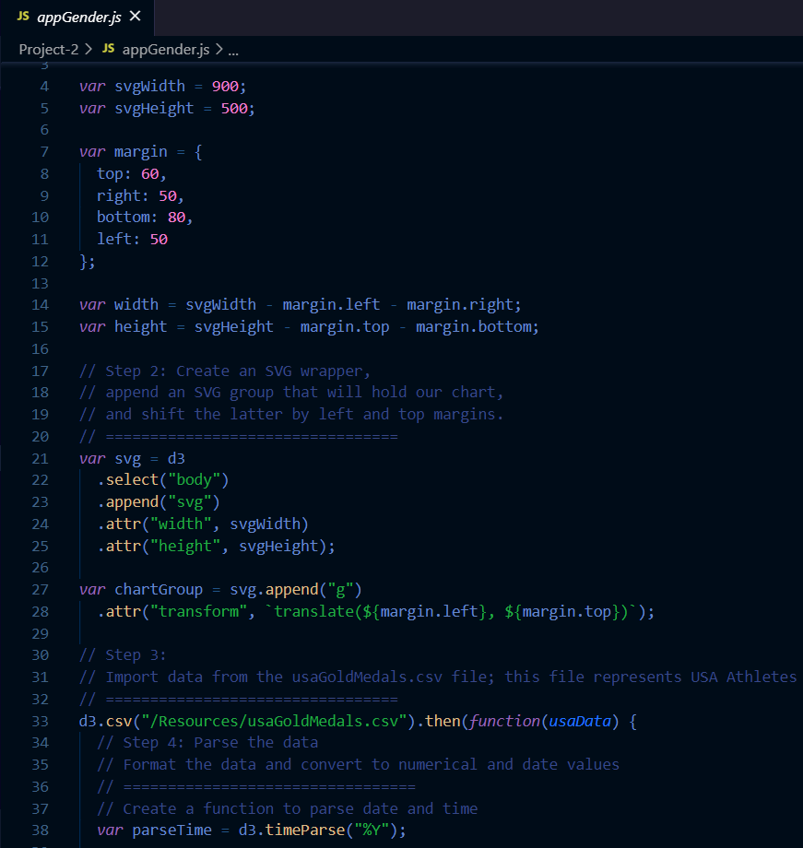
Gender Line Chart Code

Slide 8
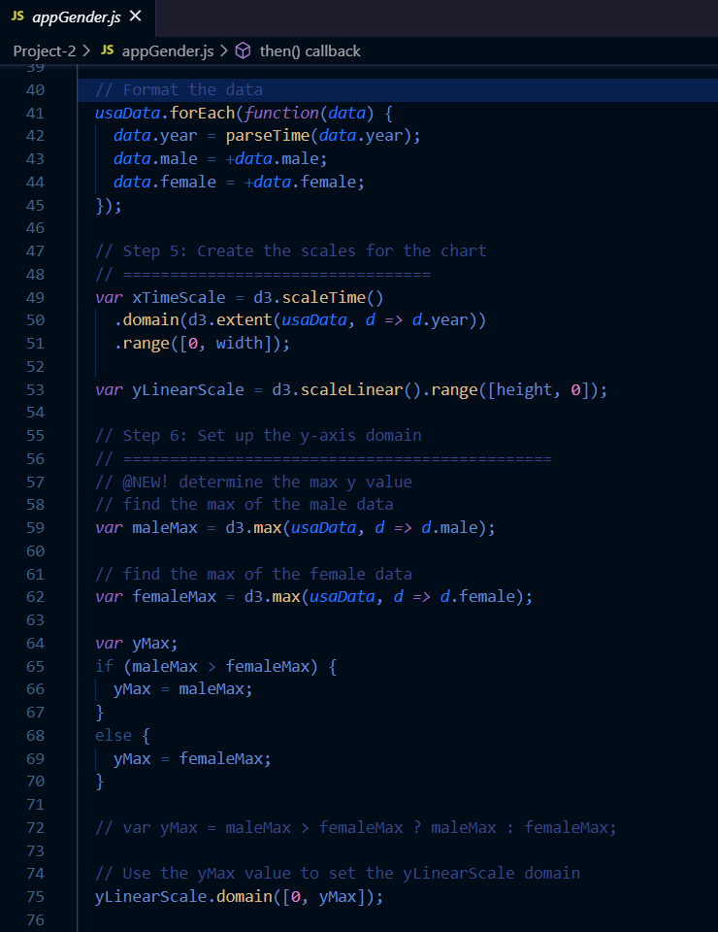
Gender Line Chart Code

Slide 9
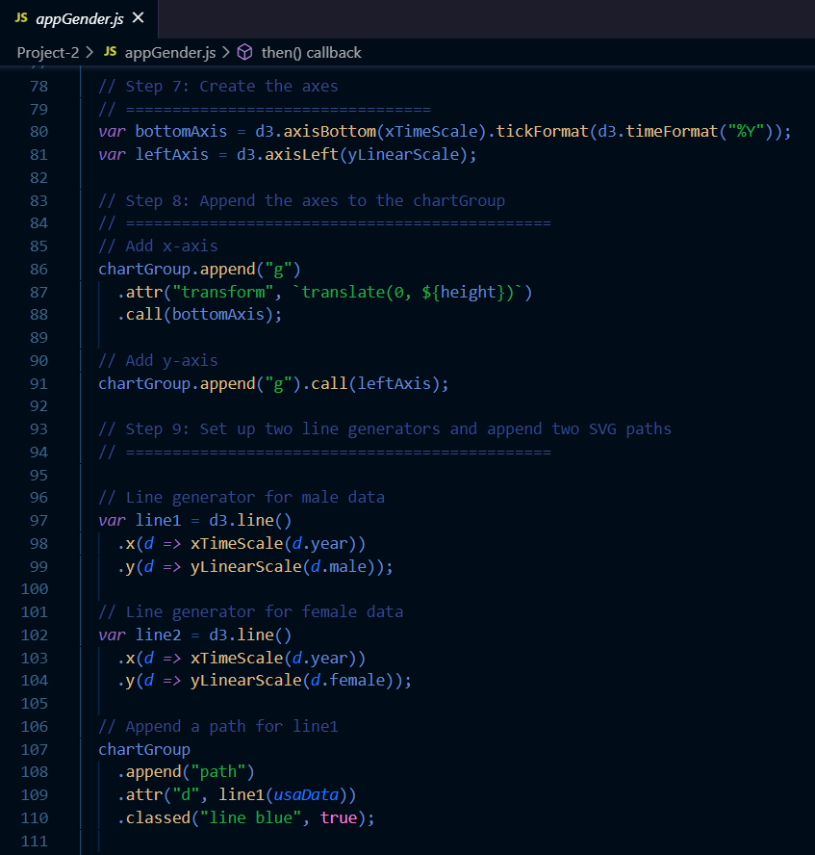
Gender Line Chart Code

Slide 10
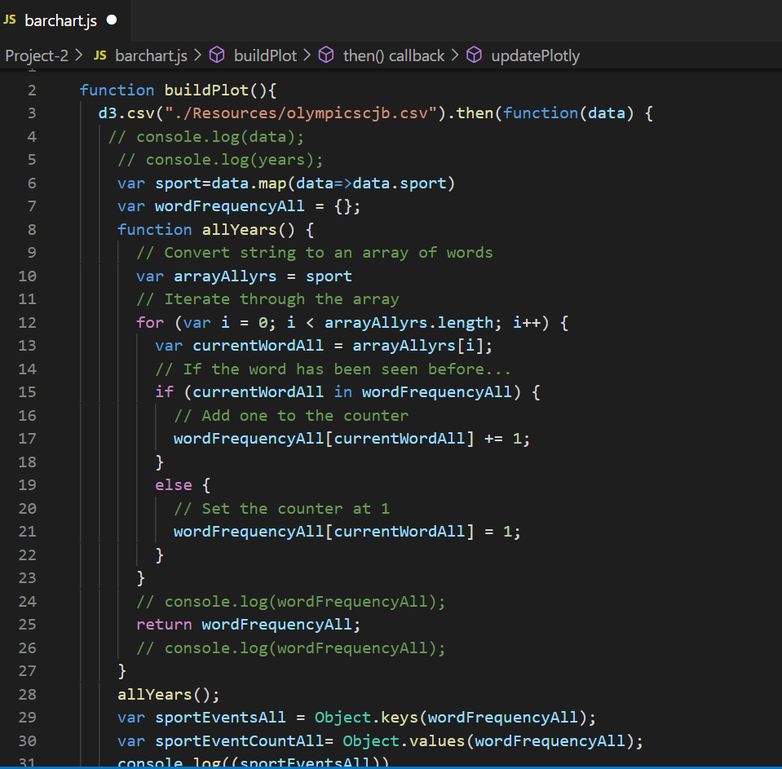
Olympic Gold Medal Events Code

Slide 11
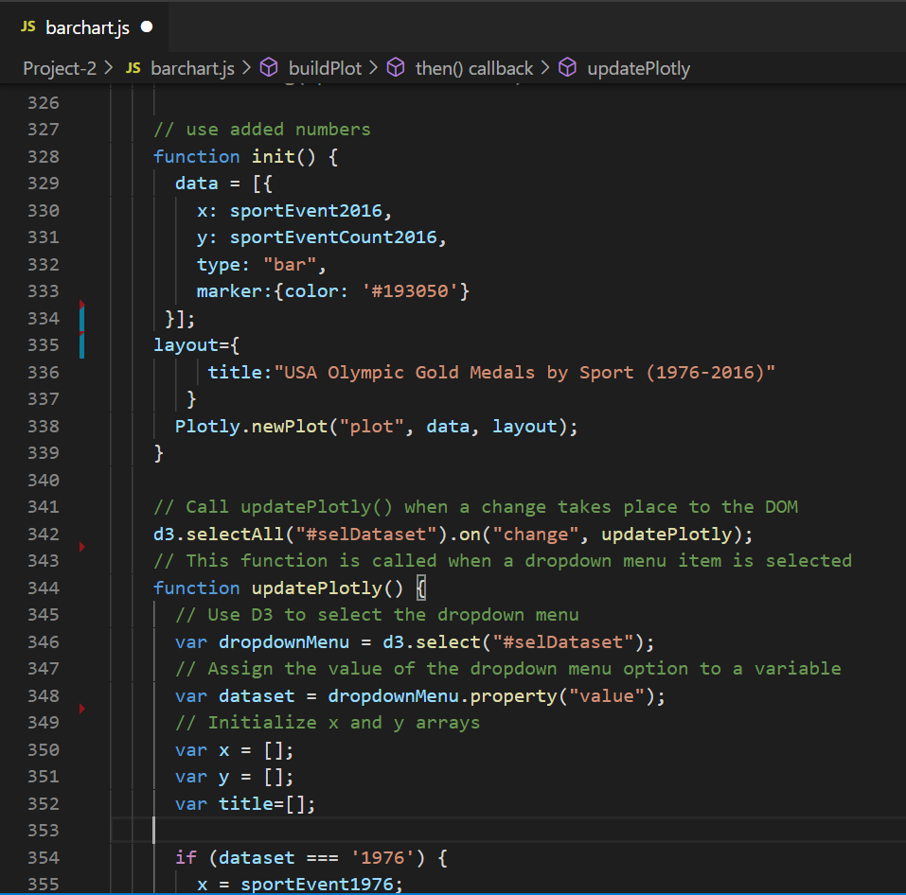
Olympic Gold Medal Events Chart Code

Slide 12
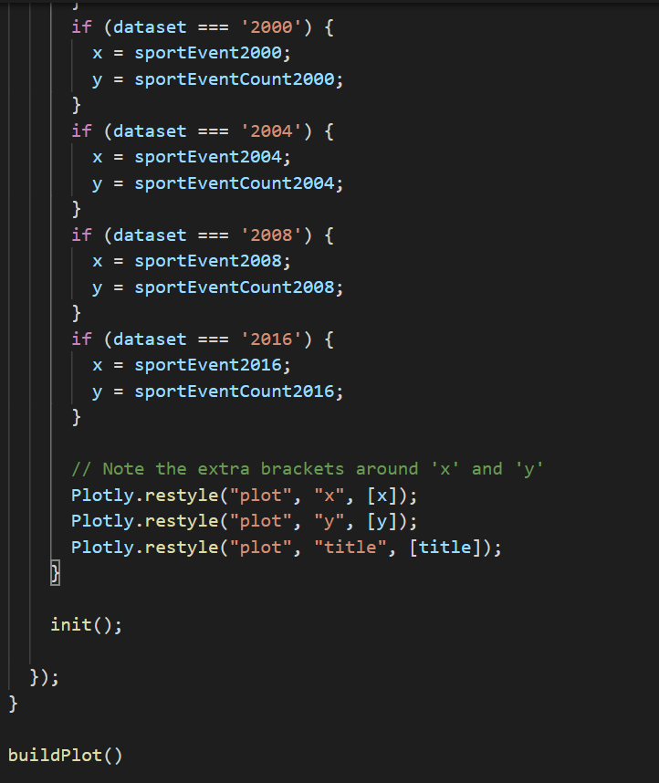
Olympic Gold Medal Events Chart Code

Slide 13
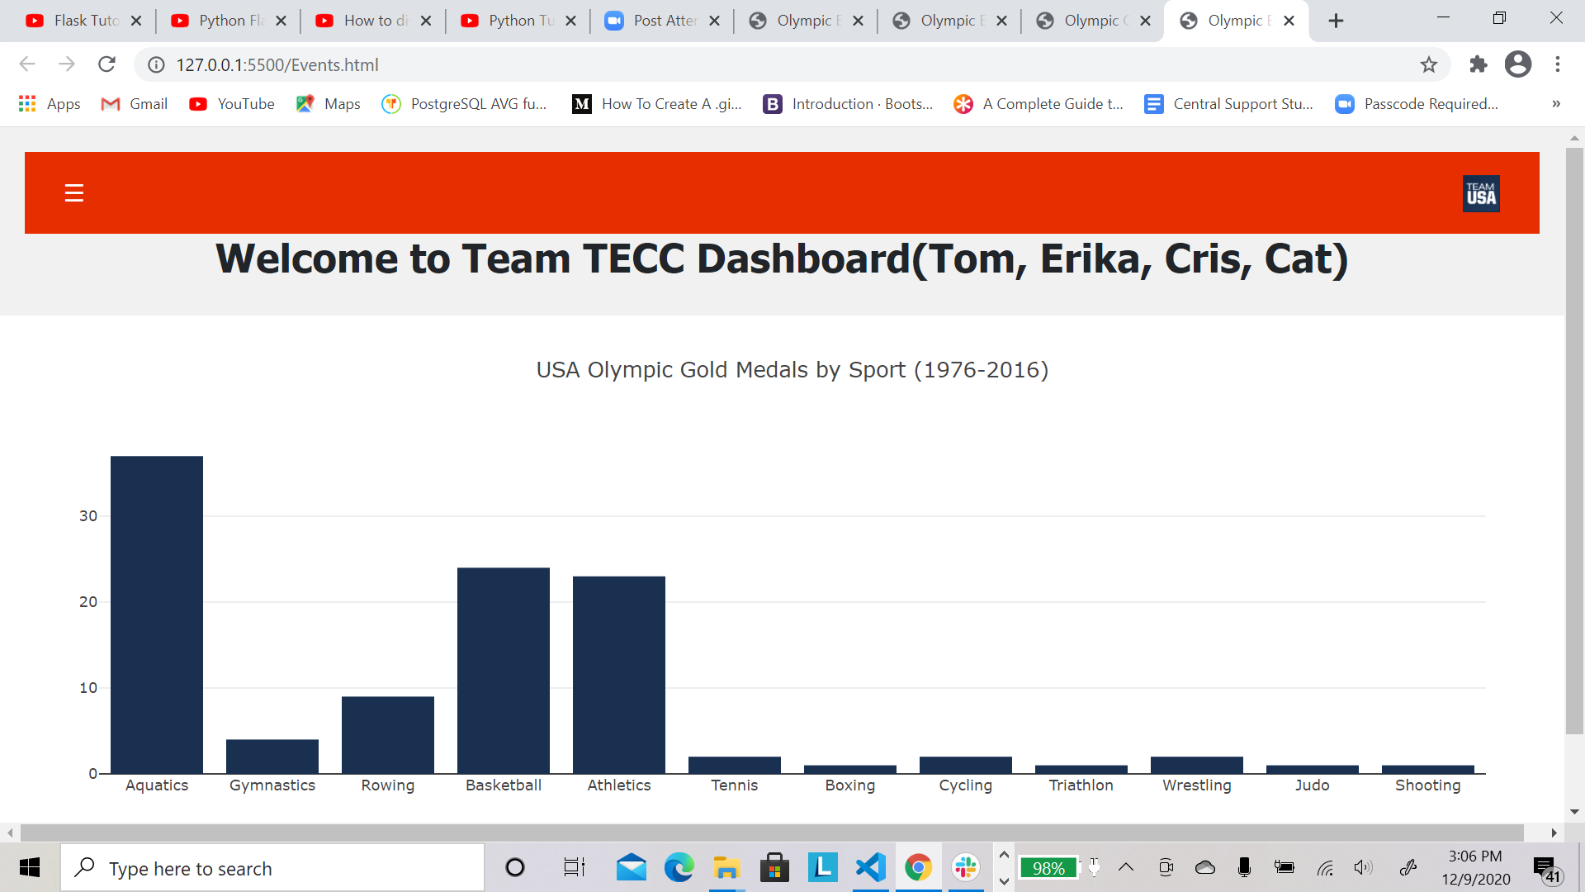
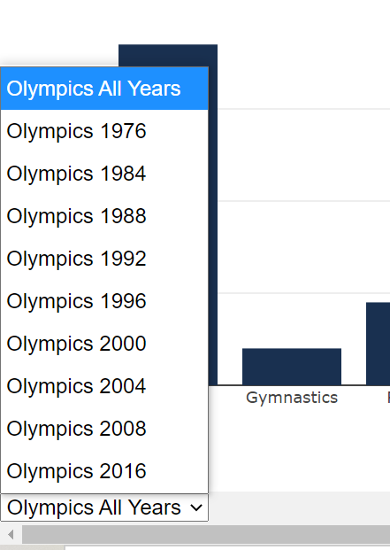
USA Gold Medals by Sports – Plot.ly

